Slide 1

CalTool
Yousuf Jazzar
Christopher Oliva
Kyle Custodio
Kent Templin
Albert Jean
Kason Alstatt
Piyush Mewada

Slide 2
Deliverable 1 Presentation Agenda
Team Introduction
Initial Project “CalTool” Ideas
Software Process Model
Requirements
Diagrams
Use Case Diagram
Sequence Diagrams
Class Diagrams
Architectural Design

Slide 3
Deliverable 2 Presentation Agenda
Project Scheduling
Cost, Effort, and Price Estimation
Estimated Hardware Costs
Estimated Software Costs
Estimated Personnel Costs
Test Plan
(CalTool Presentation (?))
Comparison of Our Work with Similar Designs
Conclusion
References

Slide 4
Deliverable 1

Slide 5
Team
Project name: CalTool
Team Members: Yousuf Jazzar
Christopher Oliva
Kyle Custodio
Kent Templin
Piyush Mewada
Kason Alstatt
Albert Jean

Slide 6
Software Process Model
Incremental Process Model
Saves money and time for software engineering
Engineers can add features while programming
Used in software engineering often, fits our project needs

Slide 7
Functional Requirements
The program needs to be able to:
Display calendar with dates, current dates, and user generated events.
Display calendar in Monthly View, Weekly View, or Daily View
Read multiple event data from the user
Save multiple event data
Send event notifications

Slide 8
Non-Functional Requirements
Run in JAVA, C, C++, or Python
Total size less than 200mb
Open within 1 second
Store 100 years worth of dates
Save at least 100 user generated events

Slide 9
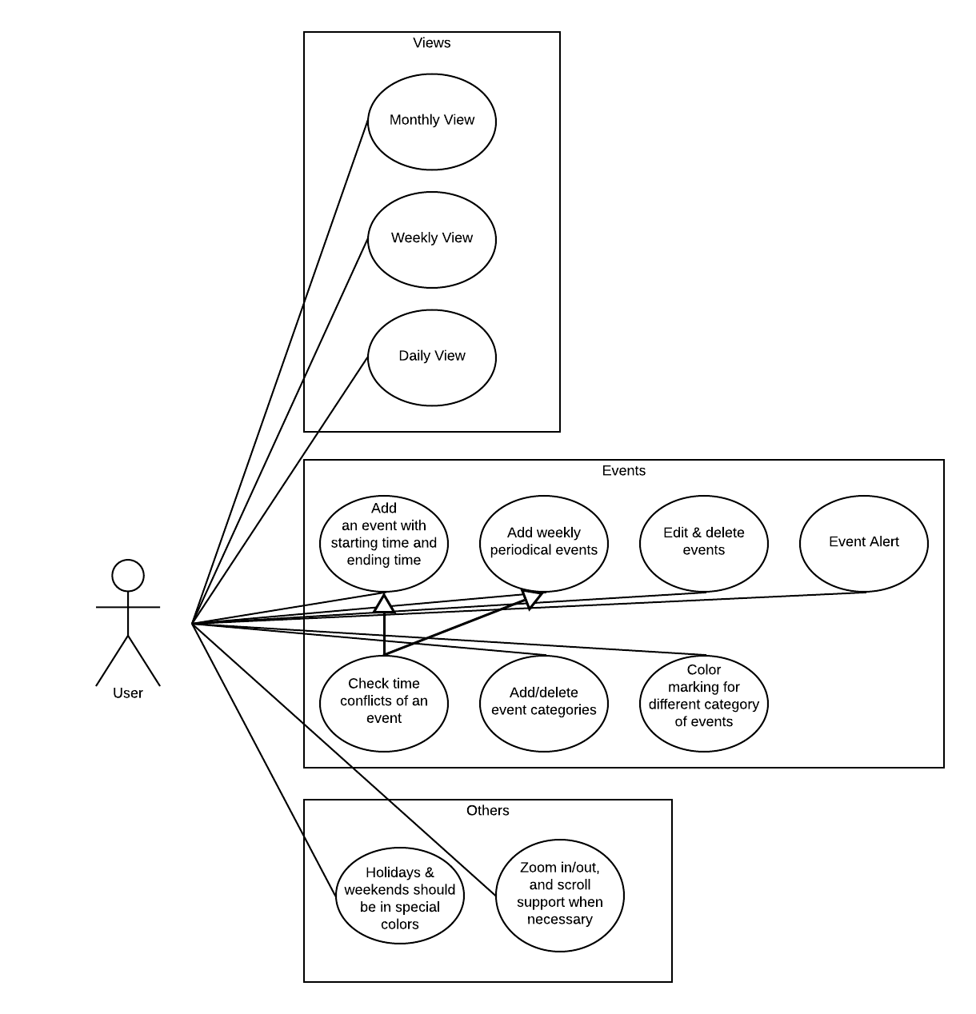
Use Case Diagram
All of the use cases available to our user

Slide 10
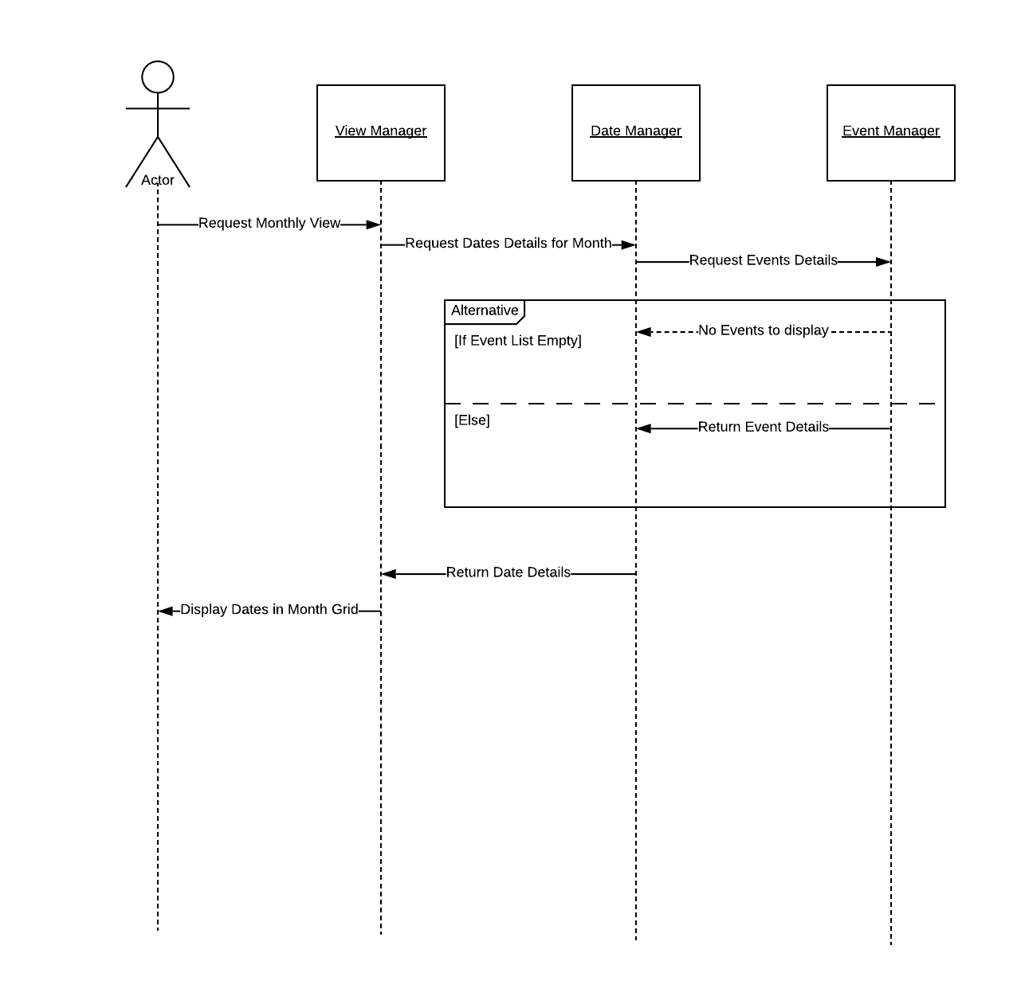
Monthly View
User will be able to see the days in a month
Events on each day listed

Slide 11
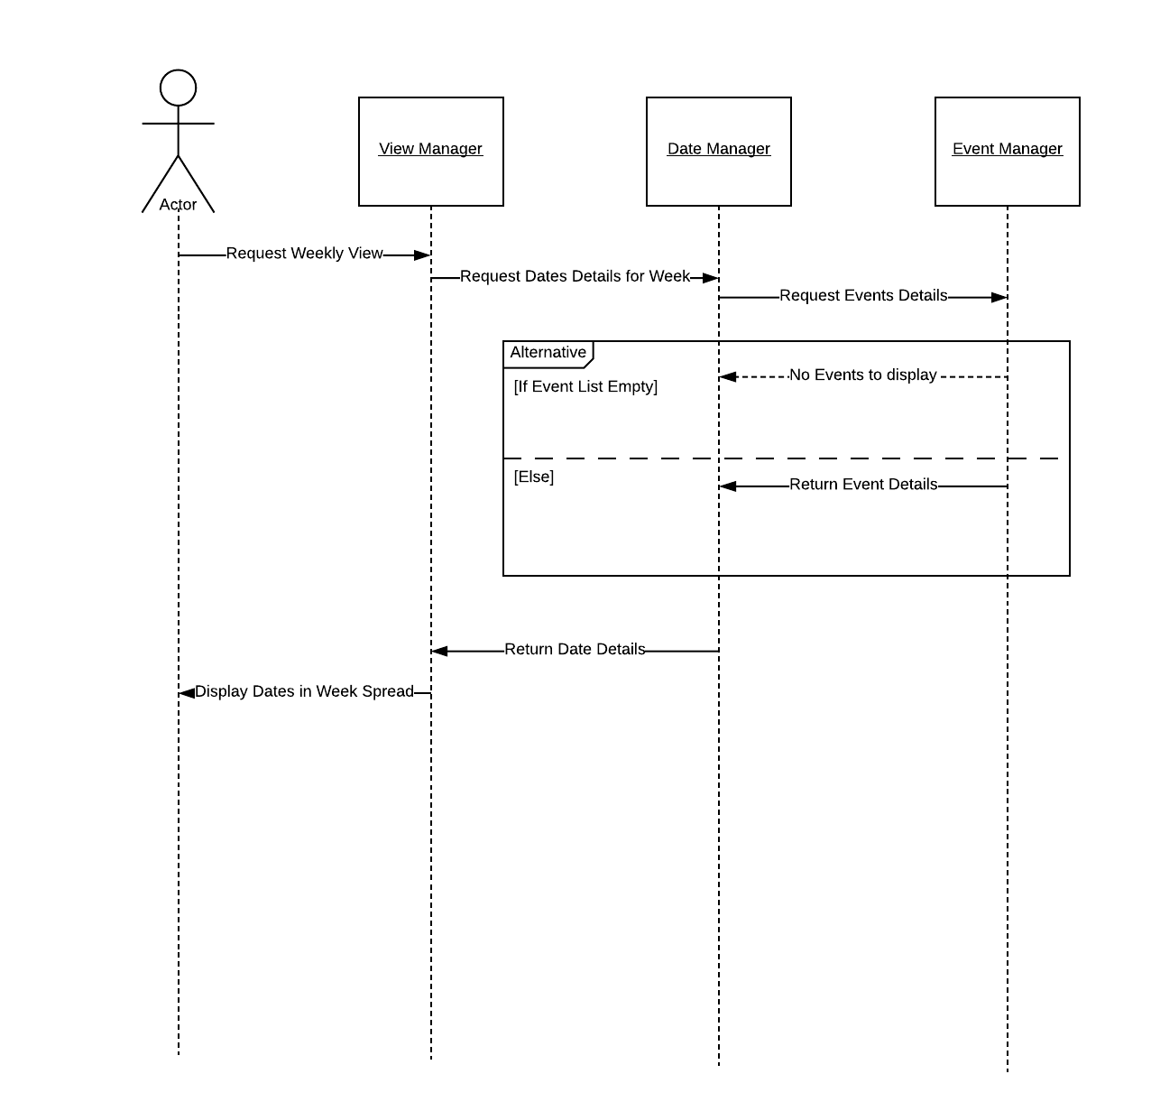
Weekly View
User will be able to see the days of the current week
Events on each day listed

Slide 12
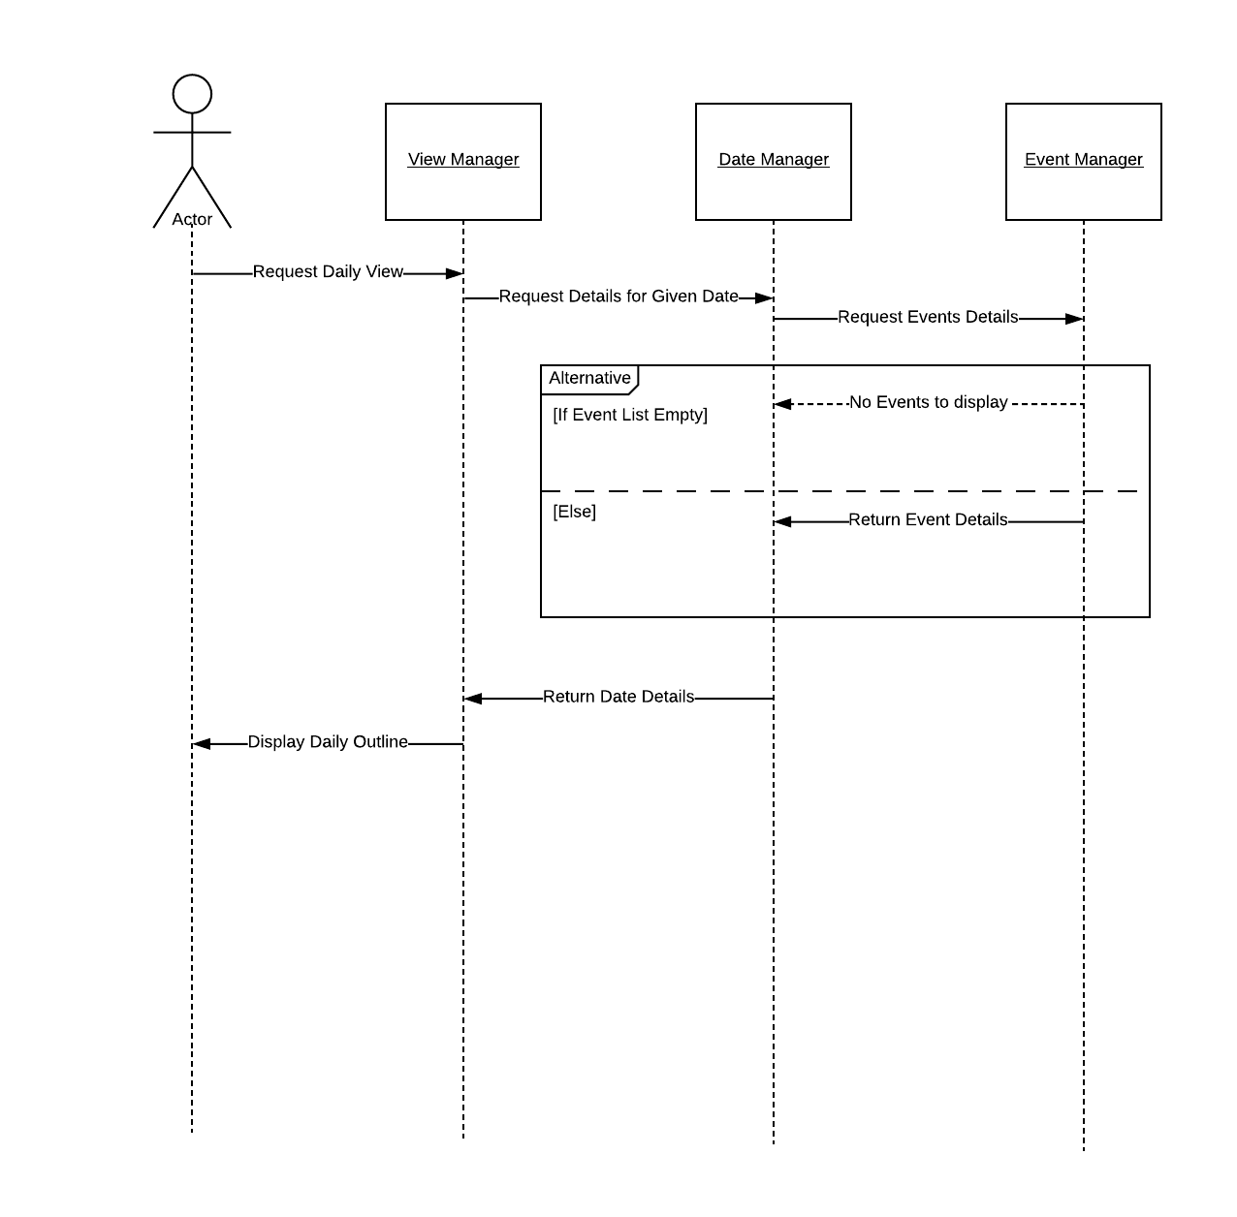
Daily View
User will be able to see the events in a given day

Slide 13
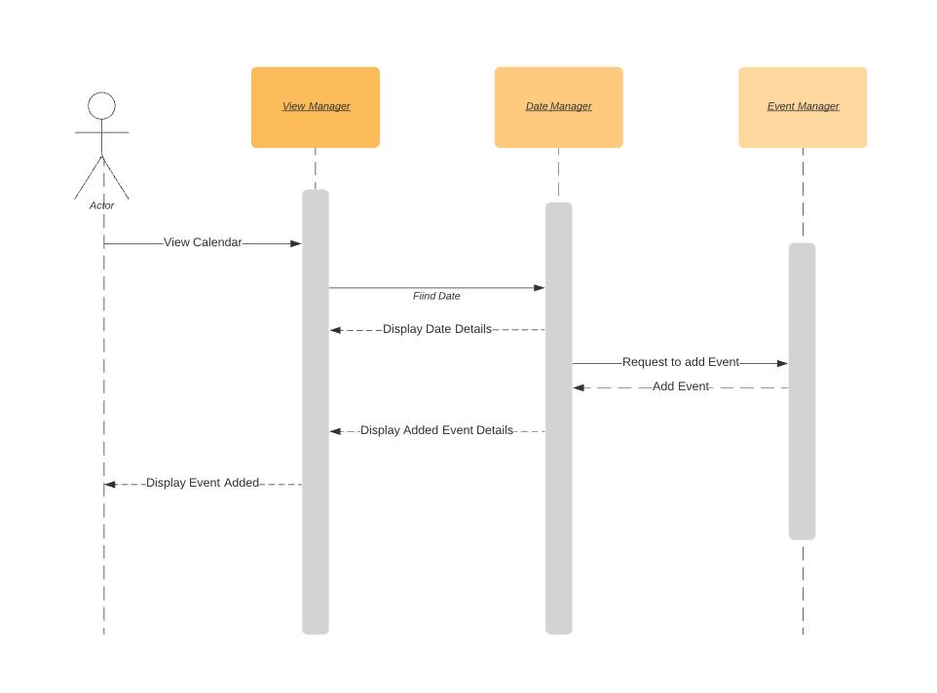
Add Event
User will be able to add an event in CalTool

Slide 14
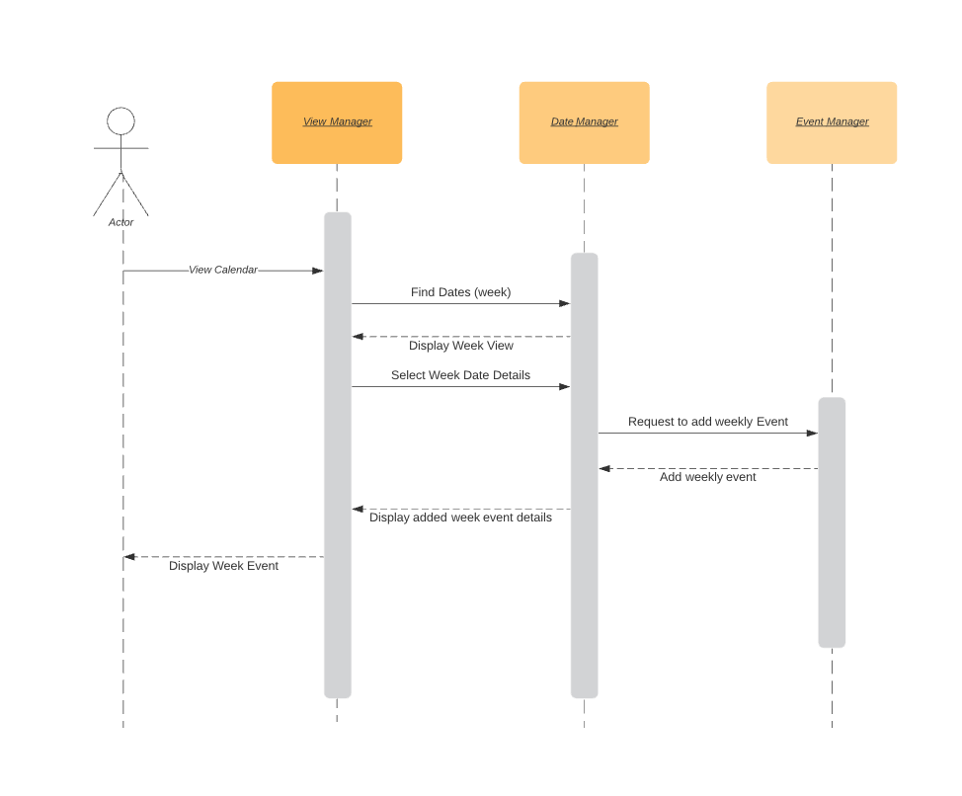
Add Weekly Event
The user will be able to add a weekly event in CalTool

Slide 15
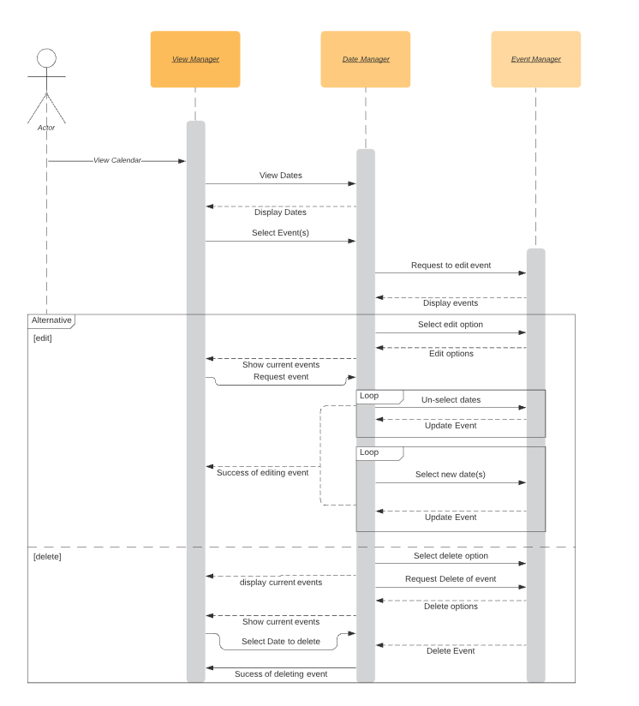
Edit and Delete Event(s)
The user will have the ability to view dates and select certain events. Within this view they will have the option to either delete and event or edit an event. Editing an event includes: altering days, changing length of event, and moving events.

Slide 16
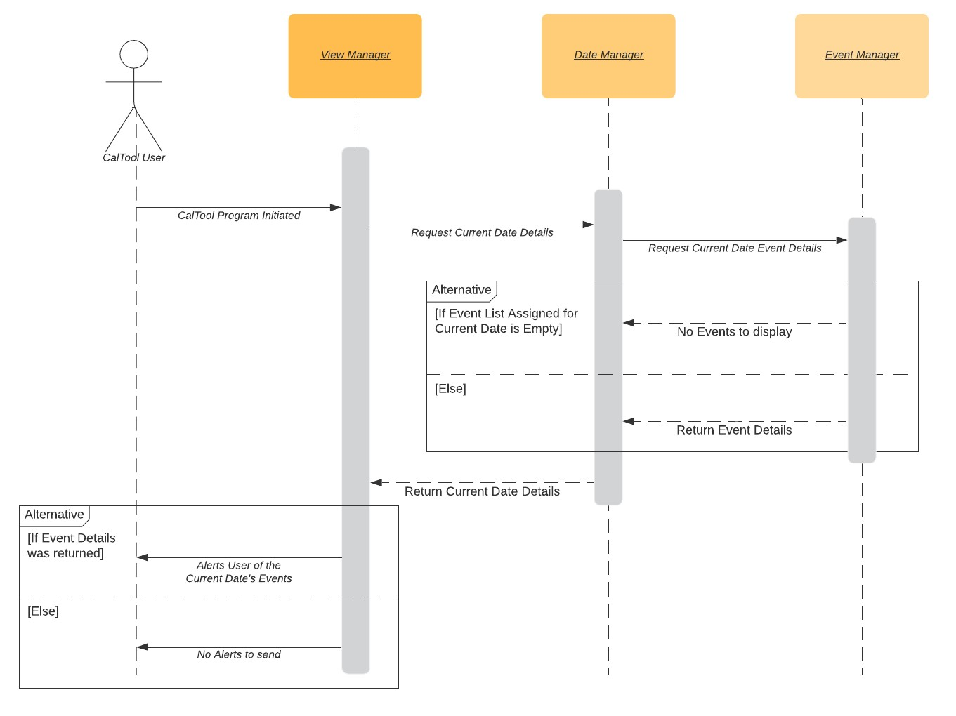
Event Alert
CalTool will alert the user with a notification of an event with its included details of the event

Slide 17
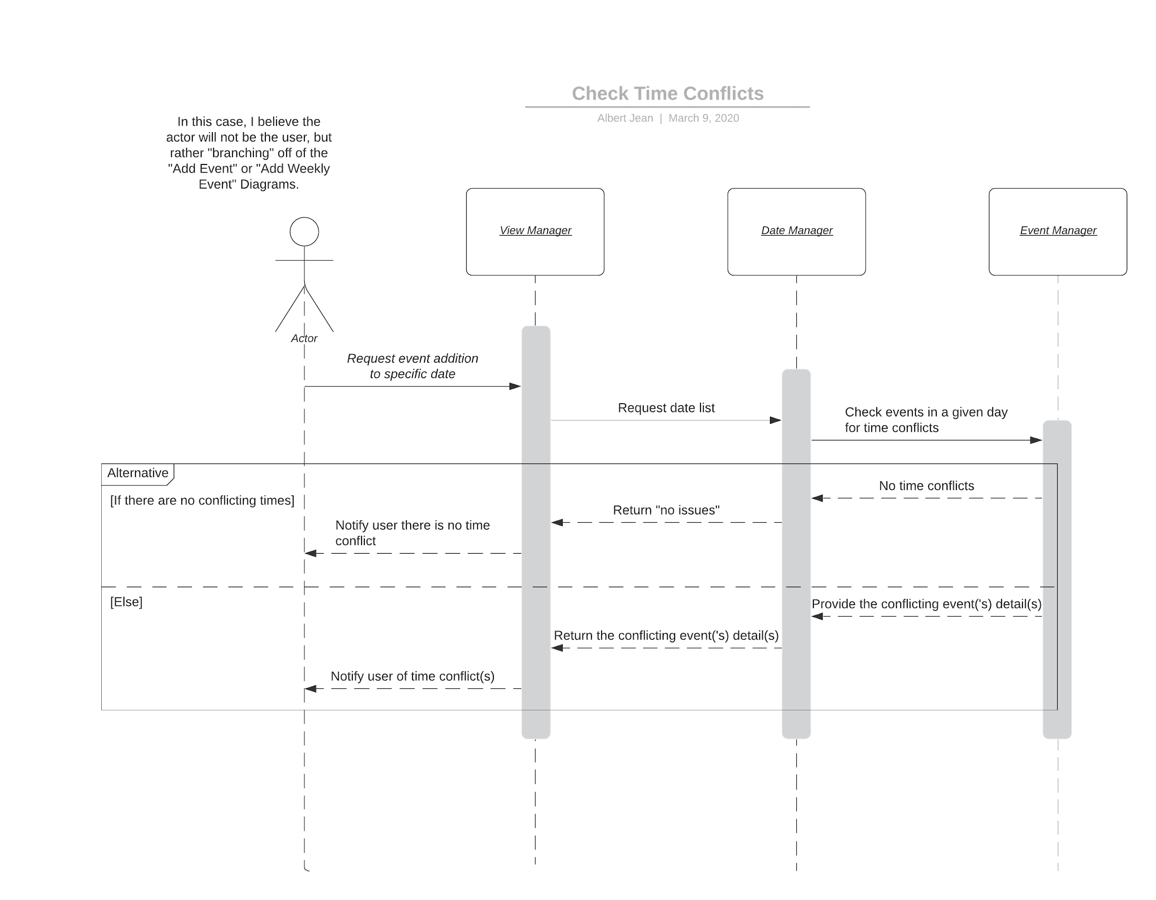
Check Time Conflict
CalTool will also check added events from the user to detect any overlap or conflicts with the user’s added events.

Slide 18
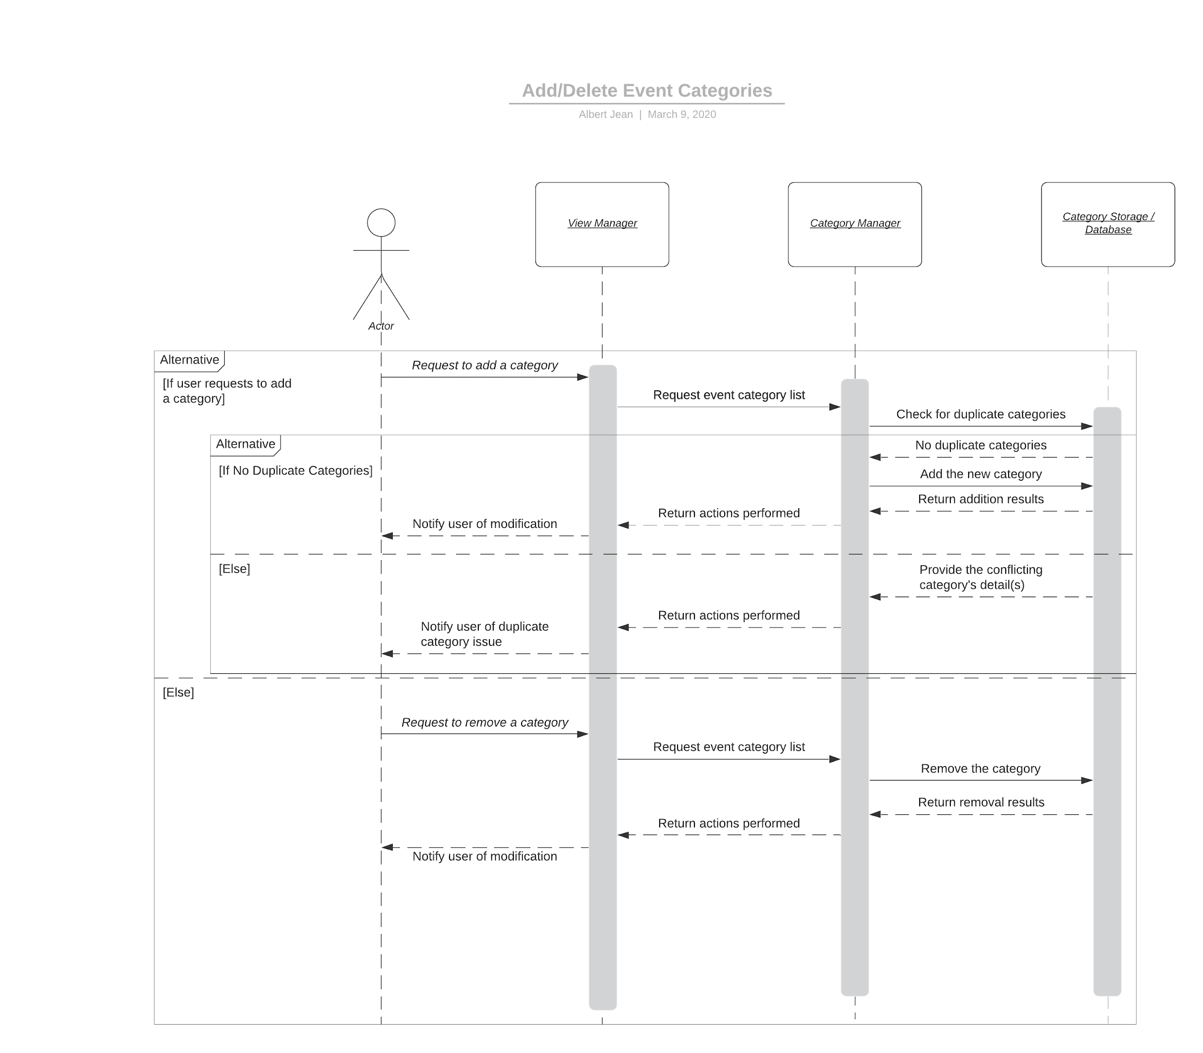
Add/Delete Event Categories
User will be able to add categories after checking if the category has been added previously. If a duplicate event is created the user is notified of a duplicate category. User also has the option to remove/delete the category.

Slide 19
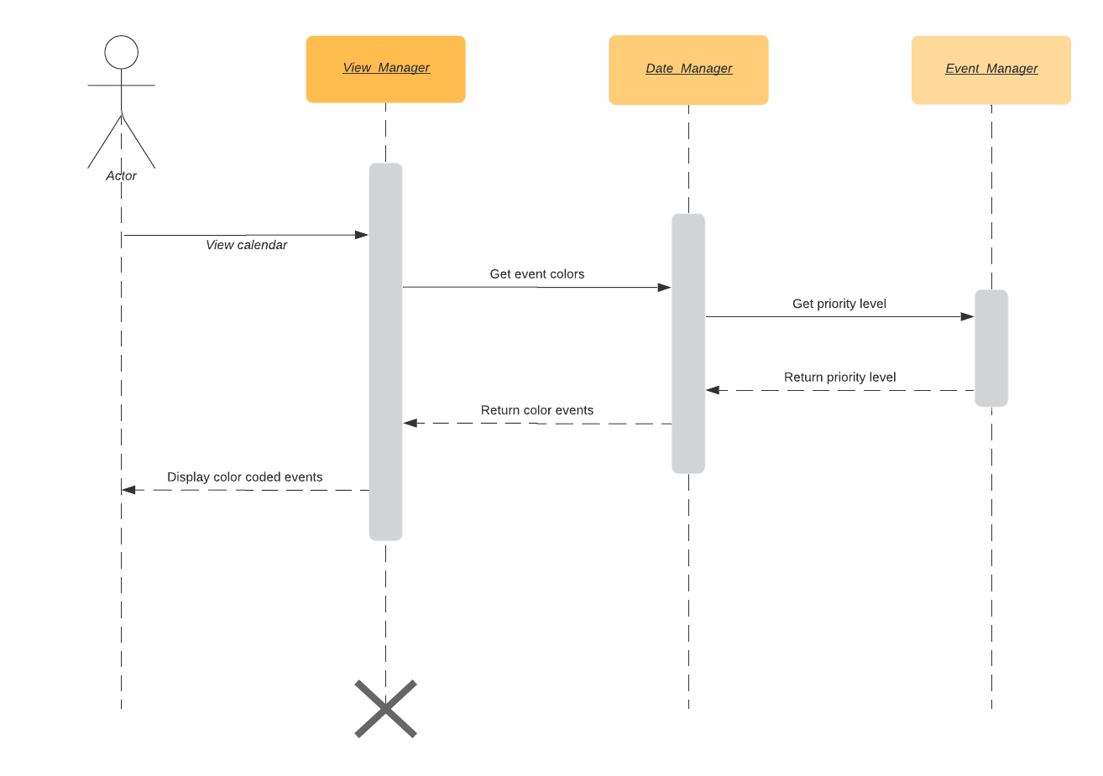
Color Mark Events
User will be able to mark events by their priority

Slide 20
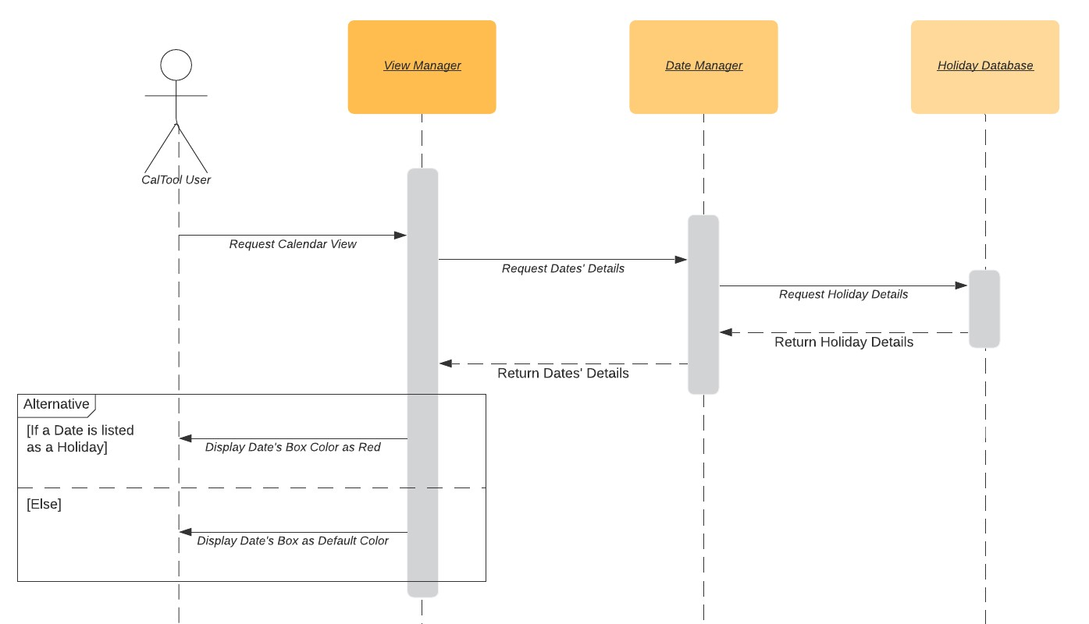
Special Holiday Mark
Holidays will have different event colors along with its listed details

Slide 21
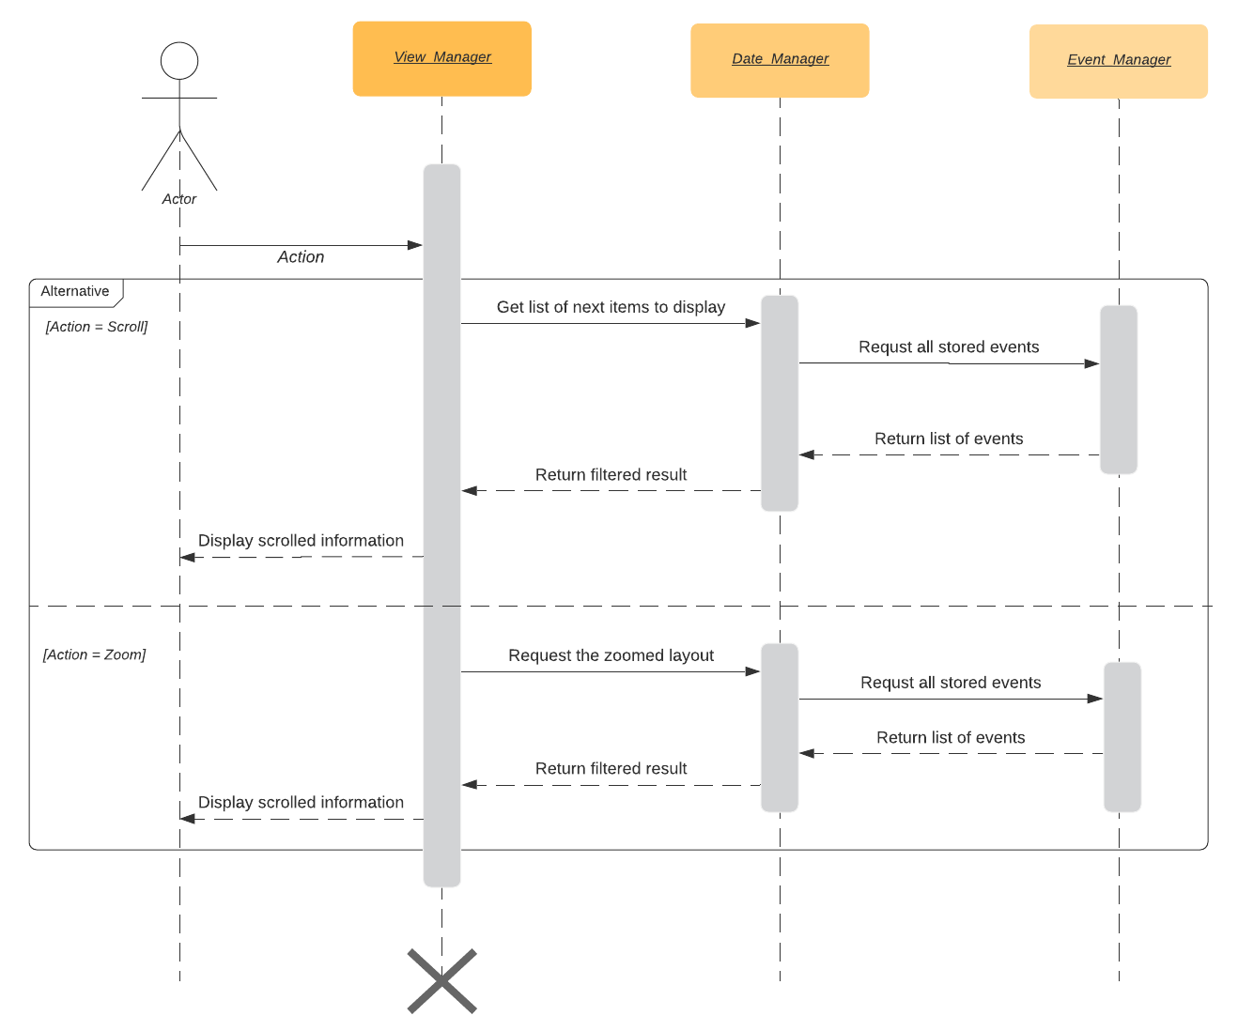
Zoom and Scroll
CalTool will allow the user to scroll past their events and calendar. Zoom support will also be included.

Slide 22
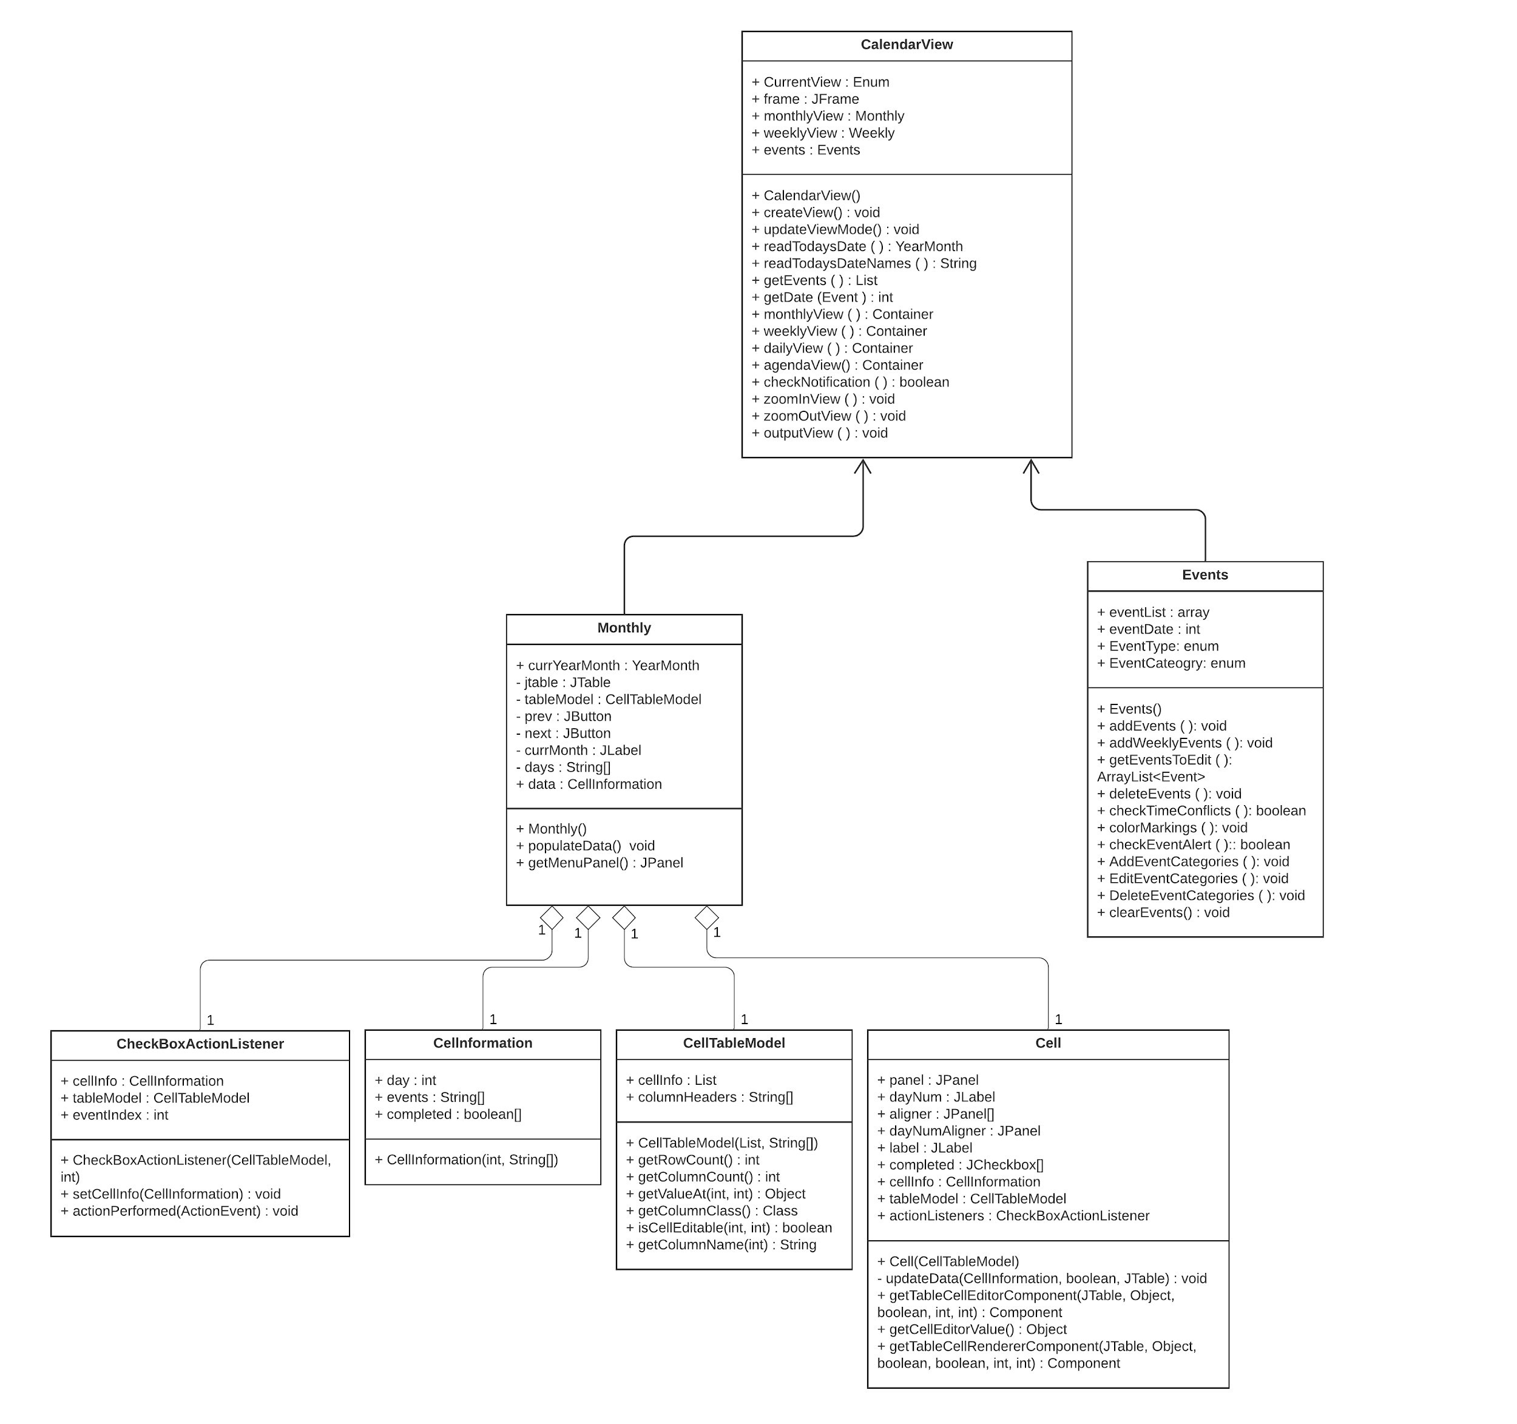
Class Diagram
//anything info we need to include

Slide 23
Architectural Design: Model View Controller
Advantages for using the MVC Architectural Design :
Data can be manipulated in various ways to the view which interacts with the data aspect
Support the presentation of our CalTool in different ways for various days/weeks/months with multiple events
MVC is heavily used future exchanges and presentation of data are unknown
Future development and alterations are easier
Supports multiple views of the models for CalTool
MVC facilitates good cohesion with alterations on the controller
Separation of managements allows more flexibility with the MVC

Slide 24
Model View Controller
Controller
View Selection
View
Charts user activity to model updates
Selects View for feedback
Determines application operations
Renders model of view(s) (Daily, Weekly, Monthly)
Requests updates on view(s) (Daily, Weekly, Monthly)
Sends events to controller
User Events
Change Notification
State Change
Model
State Query
Expresses application’s state
Responds to updates/changes made
Notifies user of changes made

Slide 25
Deliverable 2

Slide 26
Project Scheduling
Task | Effort (Person Days) | Duration (Days) | Dependencies
T1 Build Monthly.java | 1 | 3
T2 Build Weekly.java | 1 | 2 | T1 (M1)
T3 Build Daily.java | 1 | 2 | T1 (M2)
T4 Build Main.java | 1 | 2 | T1, T2, T3 (M4)
T5 Build GUI (view.java) | 1 | 3 | T1, T4 (M5)
T6 Build JUnit Class | 1 | 2 | T1, T2, T3, T4 (M6)
T7 Write Deliverable 2 Document | 3 | 4
T8 Create Slide Presentation | 2 | 3 | T7 (M3)
T9 Record Presentation | 1 | 2 | T1, T2, T3, T4, T5, T6, T8 (M7)

Slide 27
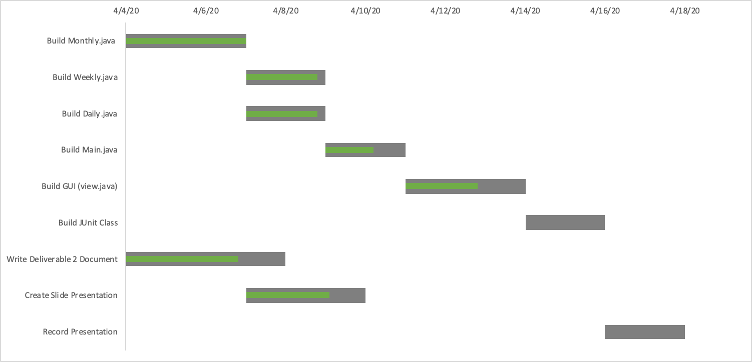
Project Scheduling

Slide 28
Cost, Effort, and Price Estimation
Cost - $24,780
Effort – 9.231 person-weeks
Price Estimation - $0.00
To compete with other calendar apps CalTool will be free
Source of revenue, advertisements
If each ad gained $0.01, and 1,000,000 people saw a single ad, we would gain $10,000
If each of the 1,000,000 people saw 3 ads, we would gain $30,000

Slide 29
Estimated Costs
Hardware Products:
3 Developers and each need a computer
Cost of Computer - $600
Server not needed, store data on client
Cost of Hardware - $1,800
Software:
Java has a GNU GPL licence, thus free to use and distribute
Cost of Software - $0.00
Personnel:
7 people, no training needed, 2 weeks
Average Software Engineer Cost - $1,700/week
Cost of Personnel - $24,780

Slide 30
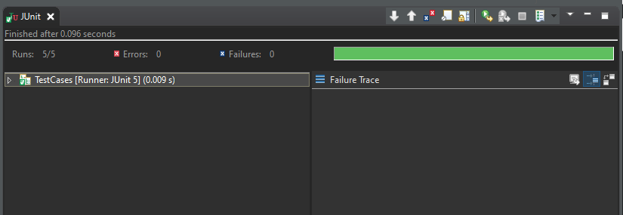
Test Plan
We used Java programming language, so we will be using Junit for our unit testing.

Slide 31
Test Plan
We chose to test the Events class within our project.
These are the test cases generated:
Testing if events add correctly (instantiation)
Testing if only valid events are added correctly (and an exception is thrown otherwise).
Testing if event attributes are added correctly
Checking if time conflicts are checked correctly
Testing to see if events can be cleared without any errors.

Slide 32
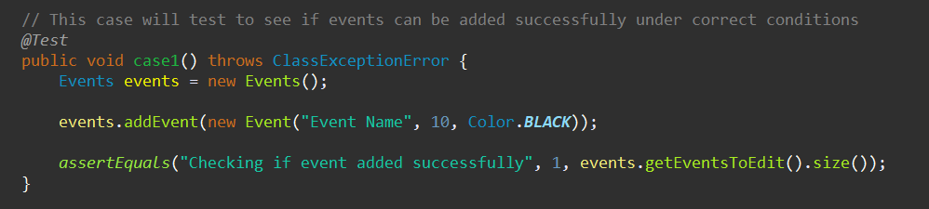
Testing if events add correctly (instantiation)

Slide 33
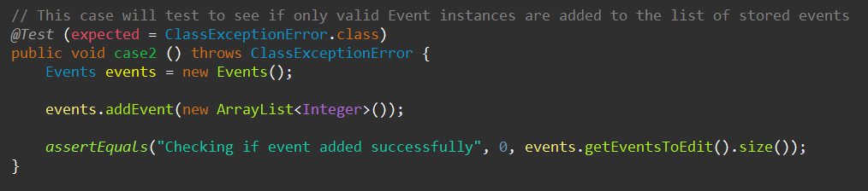
2. Testing if only valid events are added correctly

Slide 34
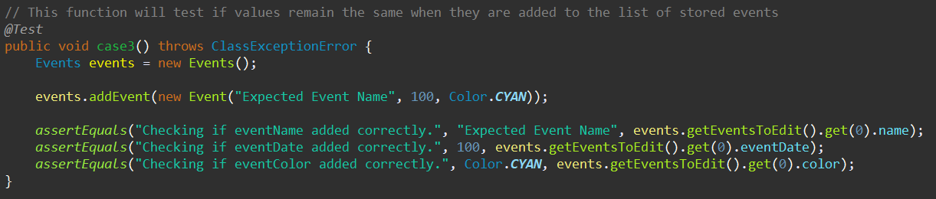
3. Testing if event attributes are added correctly

Slide 35
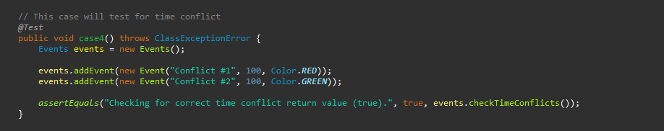
4. Checking if time conflicts are checked correctly

Slide 36
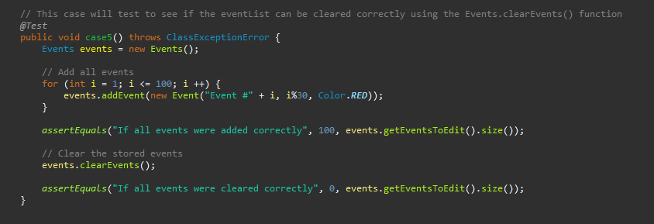
5. Testing to see if events can be cleared without any errors.

Slide 37
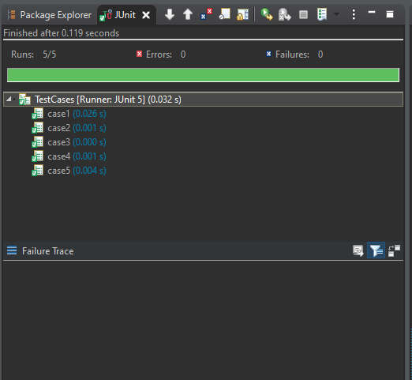
Test Plan
Result of unit testing the Events class with Junit
Results showed everything was successful

Slide 38
Comparison of Our Work with Similar Designs
Outlook Calendar
Similar Design
Extended use cases
Gives users ability to plan with others
Developed by larger company
CalTool
Focused on single user planning
More simplistic use cases

Slide 39
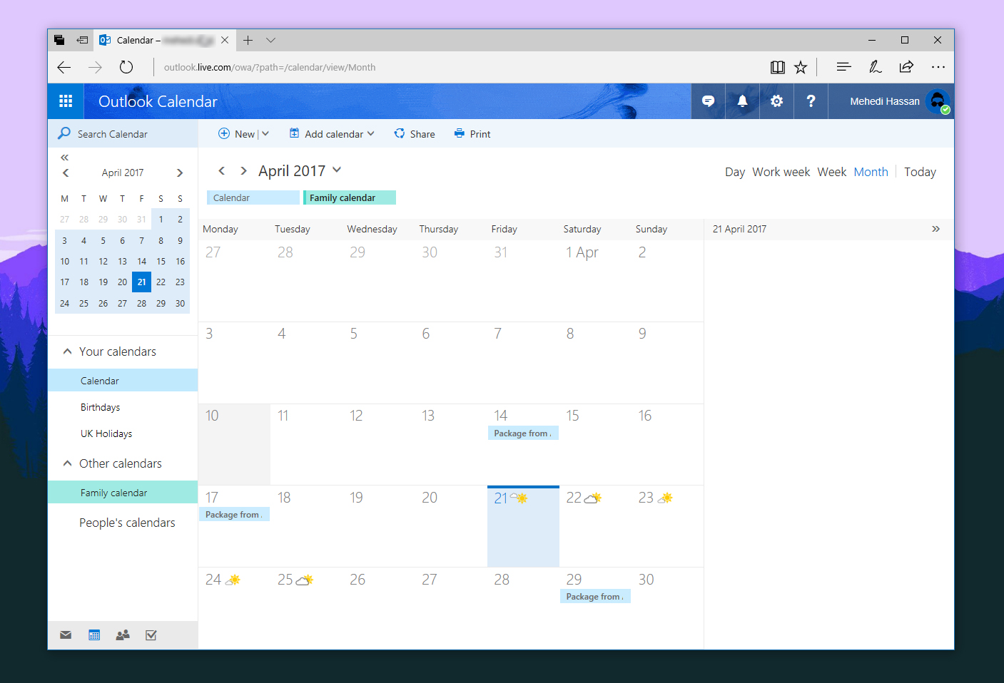
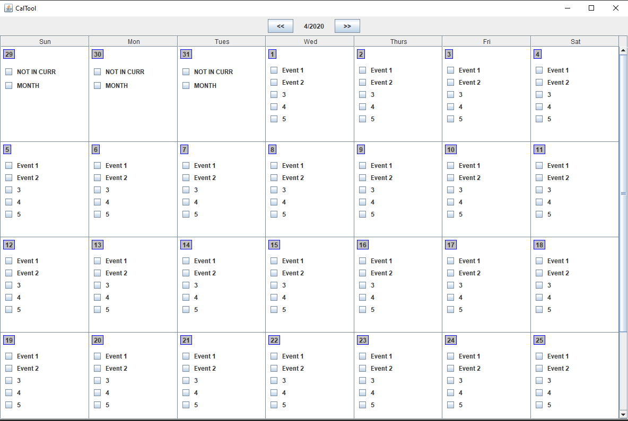
Comparison of Our Work with Similar Designs
Outlook Calendar CalTool
Figure 1: Outlook Monthly View
Source: [1]
Figure 2: CalTool Monthly View

Slide 40
Conclusion
CalTool was more complex than we thought
Required 4 additional classes
Difficult to make good looking GUI in Java
Did not realize JUnit testing was required
Initial motivation was to help plan/schedule our semester
Calendar software would help with time management
Single user ease of use will be helpful to our fellow classmates to plan for their semesters

Slide 41
References
[1] M. Hassan, “Microsoft adds a Family Calendar to Outlook on Windows 10, Android, iOS and more,” MSPoweruser, 21-Apr-2017. [Online]. Available: https://mspoweruser.com/microsoft-adds-family-calendar-outlook-windows-10-android-ios/. [Accessed: 12-Apr-2020].
[2] “Introduction to the Outlook Calendar,” Outlook. [Online]. Available: https://support.office.com/en-us/article/introduction-to-the-outlook-calendar-d94c5203-77c7-48ec-90a5-2e2bc10bd6f8. [Accessed: 10-Apr-2020].
[3] “Change how you view your Outlook calendar,” Outlook. [Online]. Available: https://support.office.com/en-us/article/change-how-you-view-your-outlook-calendar-a4e0dfd2-89a1-4770-9197-a3e786f4cd8f. [Accessed: 10-Apr-2020].

